Slide 1
Leech Lake Band of Ojibwe
Reservation Safety Plan Update
Meeting #1
September 19, 2022

Slide 2
Agenda
Introductions
What Is A Tribal Safety Plan?
Current Safety Data
Identify Emphasis Areas
Who/What Is Missing?

Slide 3
Introductions
Name
Agency
Position At Agency
What Is Your Vision For This Safety Plan?

Slide 4
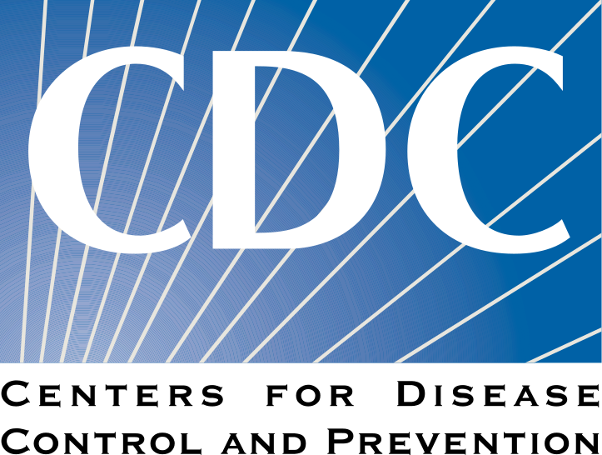
Fast Not So Fun Facts
Motor vehicle traffic crashes are a leading cause of death for American Indian and Alaska Native people
Motor vehicle traffic crash death rates among American Indian and Alaska Native children and youth age 0–19 years were about 2 to 5 times higher than those of other racial and ethnic groups
American Indian and Alaska Native persons have the highest alcohol-impaired driving death rates among all racial and ethnic groups.10 Alcohol-impaired driving death rates among American Indian and Alaska Native persons are 2 to 17 times higher than other racial and ethnic groups in the United States
Although belt use varies greatly across reservations, seat belt use among American Indians and Alaska Native persons (76%)4 is lower than that of the United States overall (90%)

Slide 5
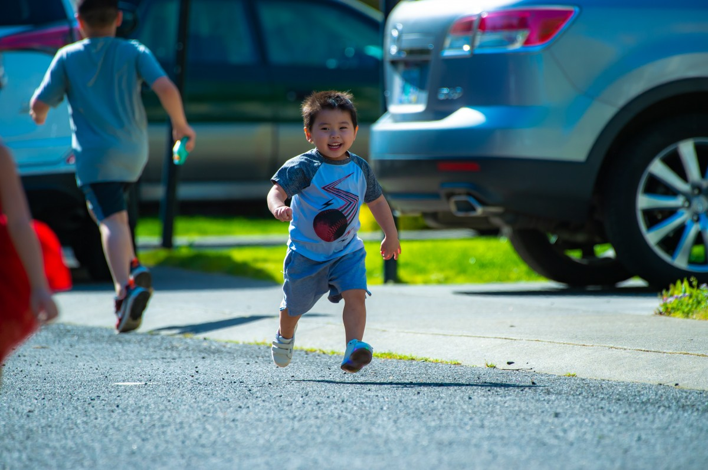
What And Why Develop A Plan?
Transportation Safety Plans
Transportation safety plans are a tool used to identify and plan to address transportation risk factors that have a potential of leading to serious injury or death. Safety Plans also organize the efforts of a variety of entities to more effectively reduce risk in all modes of transportation.
A transportation safety plan should not be developed with a focus on any one funding source. Instead, a transportation safety plan should demonstrate the safety concerns in a community and the prioritized strategies that will be explored to implement the plan. To the greatest extent possible the concerns demonstrated by a safety plan should be selected based on incident history (data).

Slide 6
What And Why Develop A Plan?
Safe Streets and Roads for All (SS4A) Discretionary Program
The Bipartisan Infrastructure Law (BIL) established the new Safe Streets and Roads for All (SS4A) discretionary program with $5 billion in appropriated funds over the next 5 years. In fiscal year 2022 (FY22), up to $1 billion is available. The SS4A program funds regional, local, and Tribal initiatives through grants to prevent roadway deaths and serious injuries (commonly referred to as “Toward Zero Deaths” initiatives.
Tribal Transportation Program Safety Fund
Each year under the Bipartisan Infrastructure Law (BIL), as enacted by the Infrastructure Investment and Jobs Act (Public Law 117-58), 4% of the available TTP funds are set aside to address transportation safety issues in Native America. TTPSF grants are available to federally recognized tribes through a competitive, discretionary program. Awarded annually, projects are chosen whose outcomes will address the prevention and reduction of death or serious injuries in transportation related incidents, such as motor vehicle crashes

Slide 7
Towards Zero Deaths

Slide 8
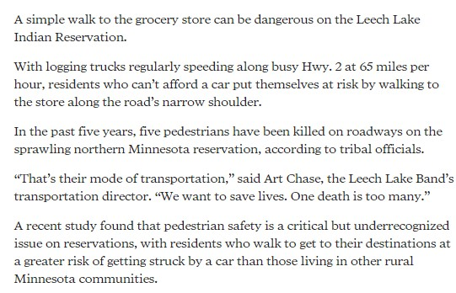
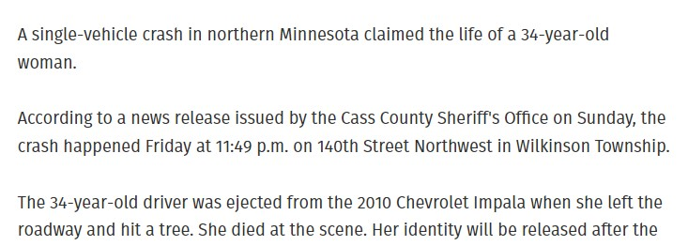

Slide 9
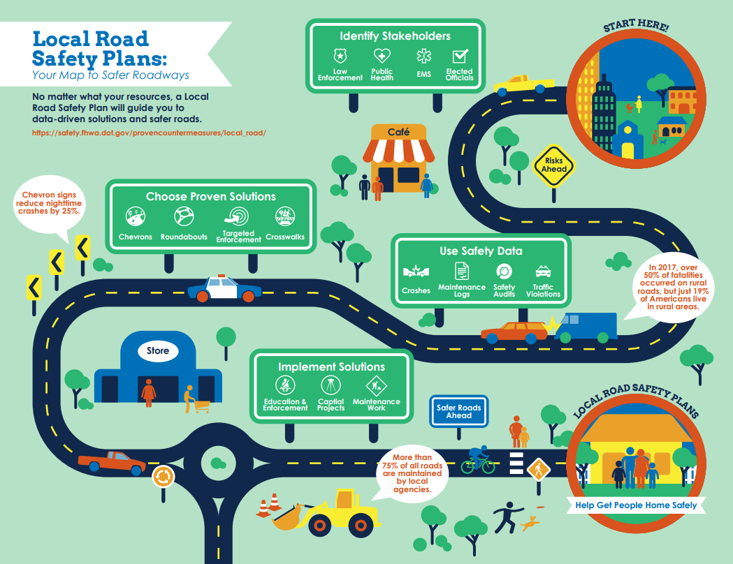

Slide 11
Road System In Leech Lake
Paved: 633 Miles
Gravel: 500 Miles
Dirt: 97.4 Miles

Slide 12
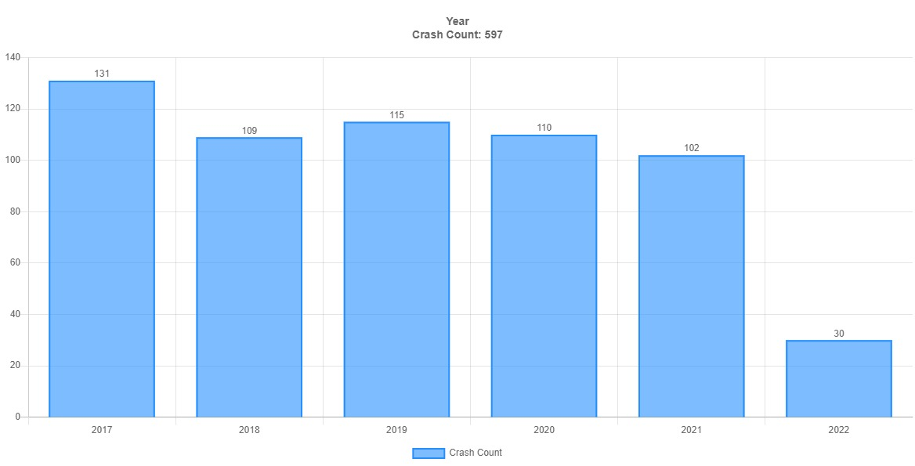
Total Reported Collisions
Jan 1, 2017 to June 30, 2022

Slide 13
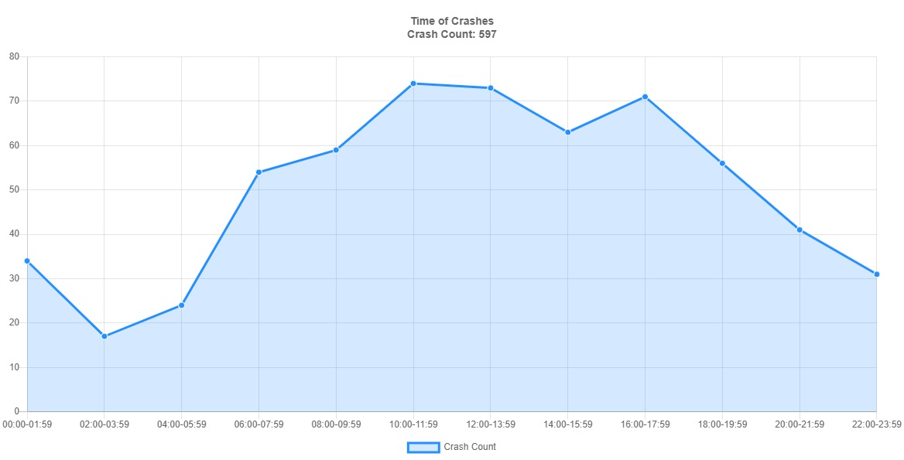

Slide 14
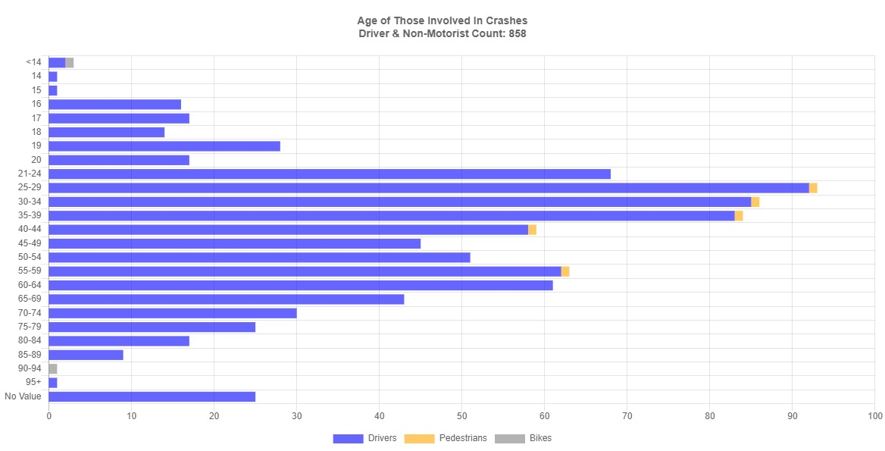

Slide 15
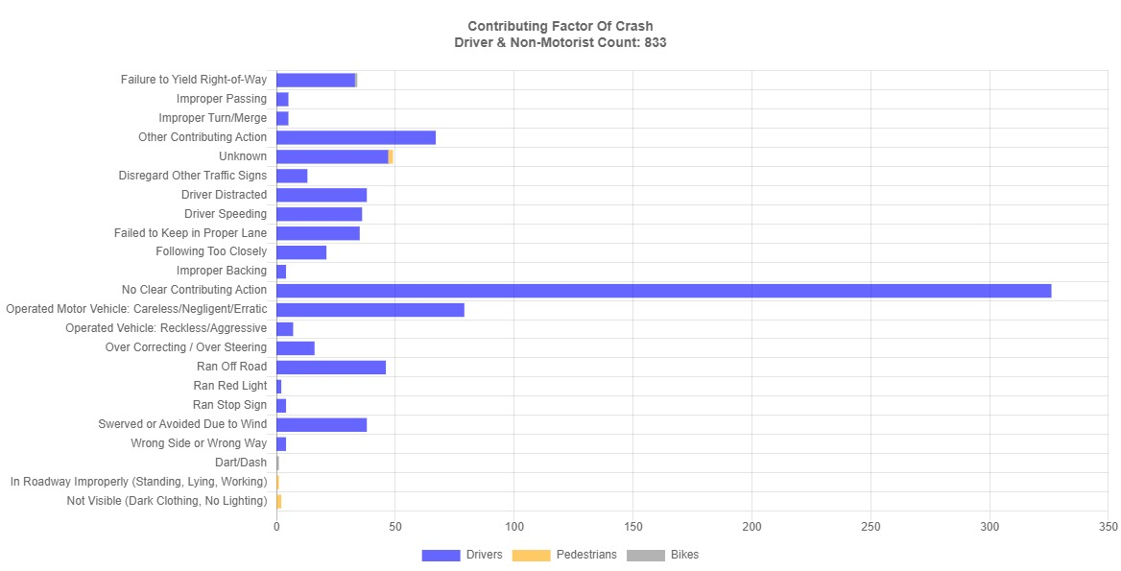

Slide 16
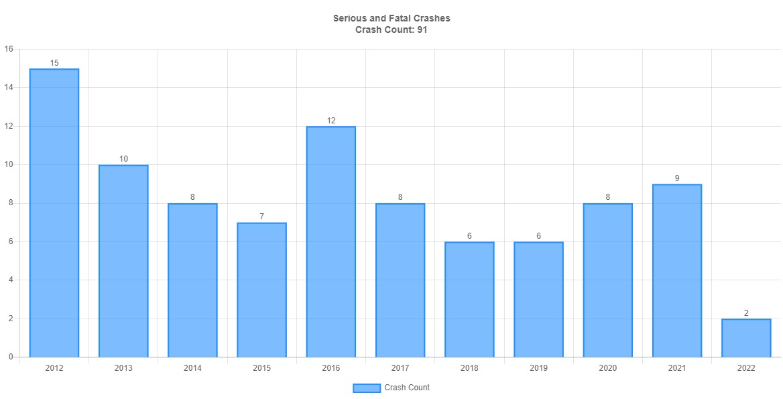

Slide 17
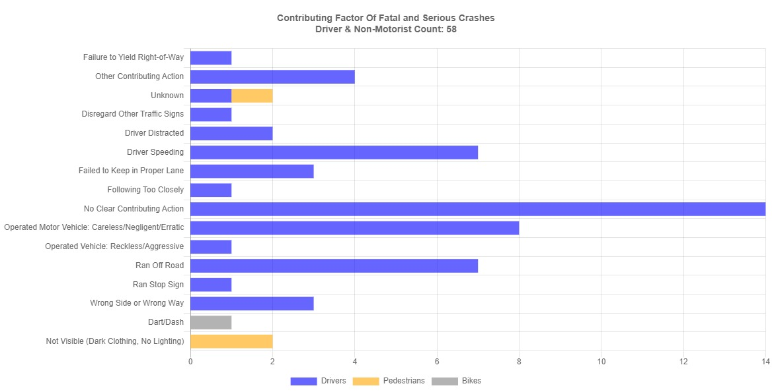

Slide 18
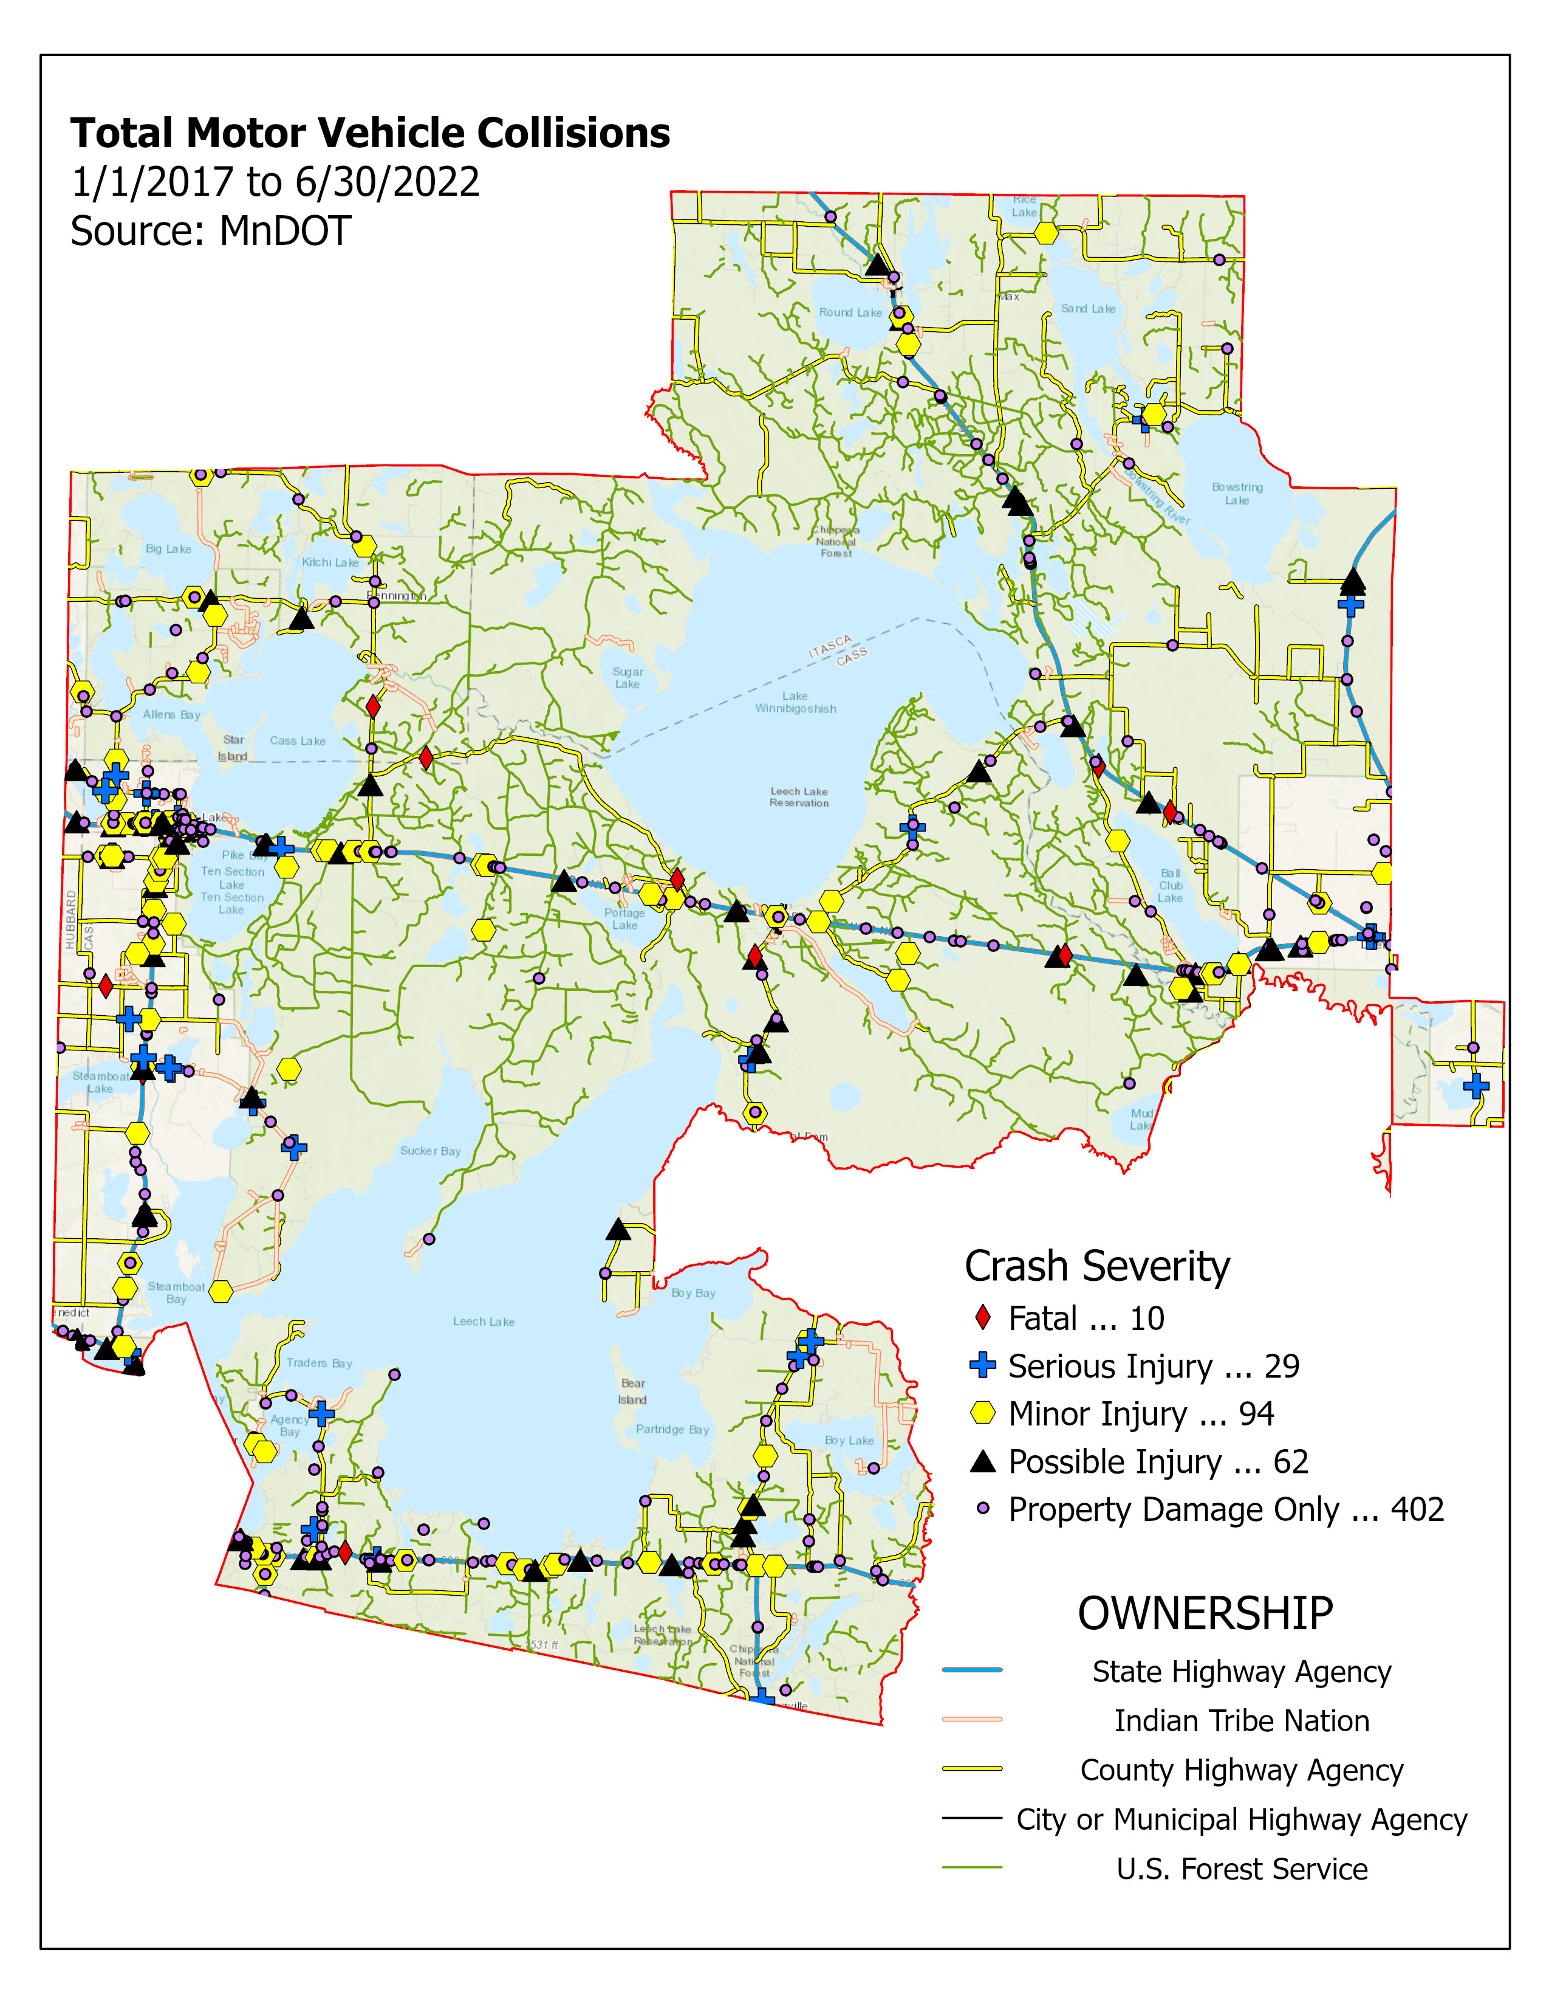
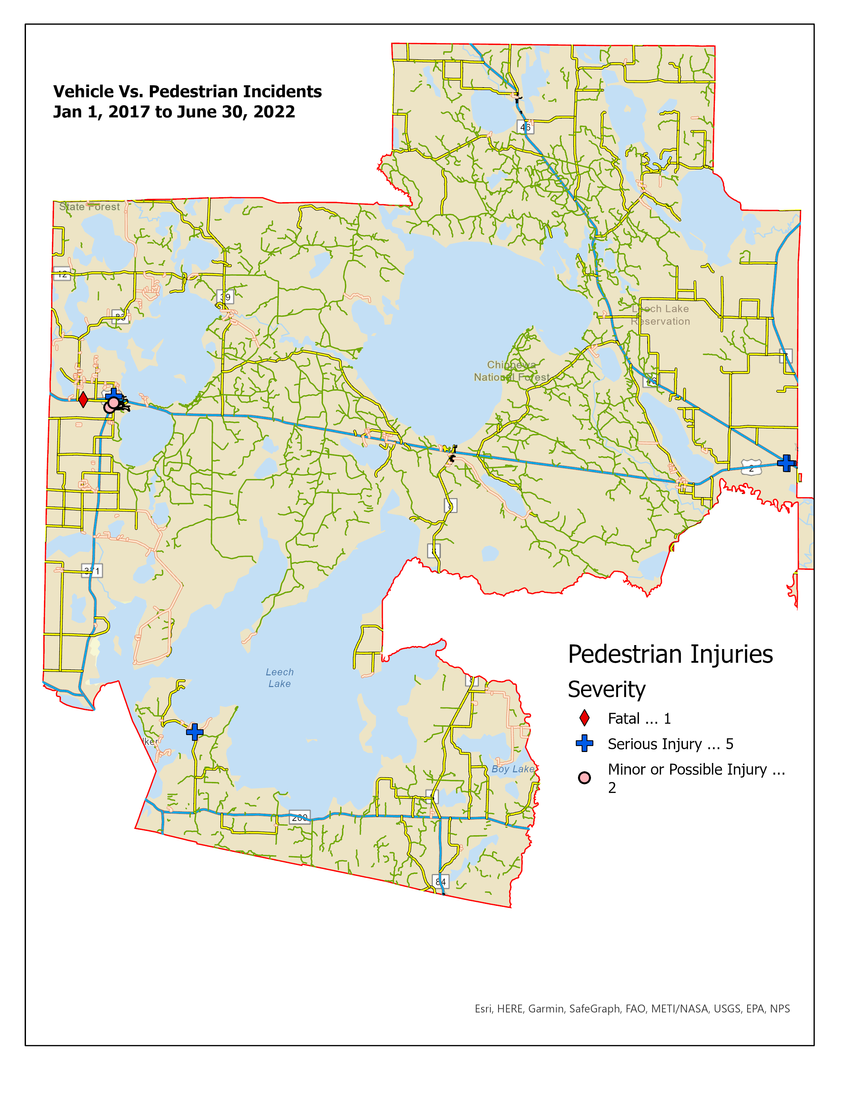

Slide 19
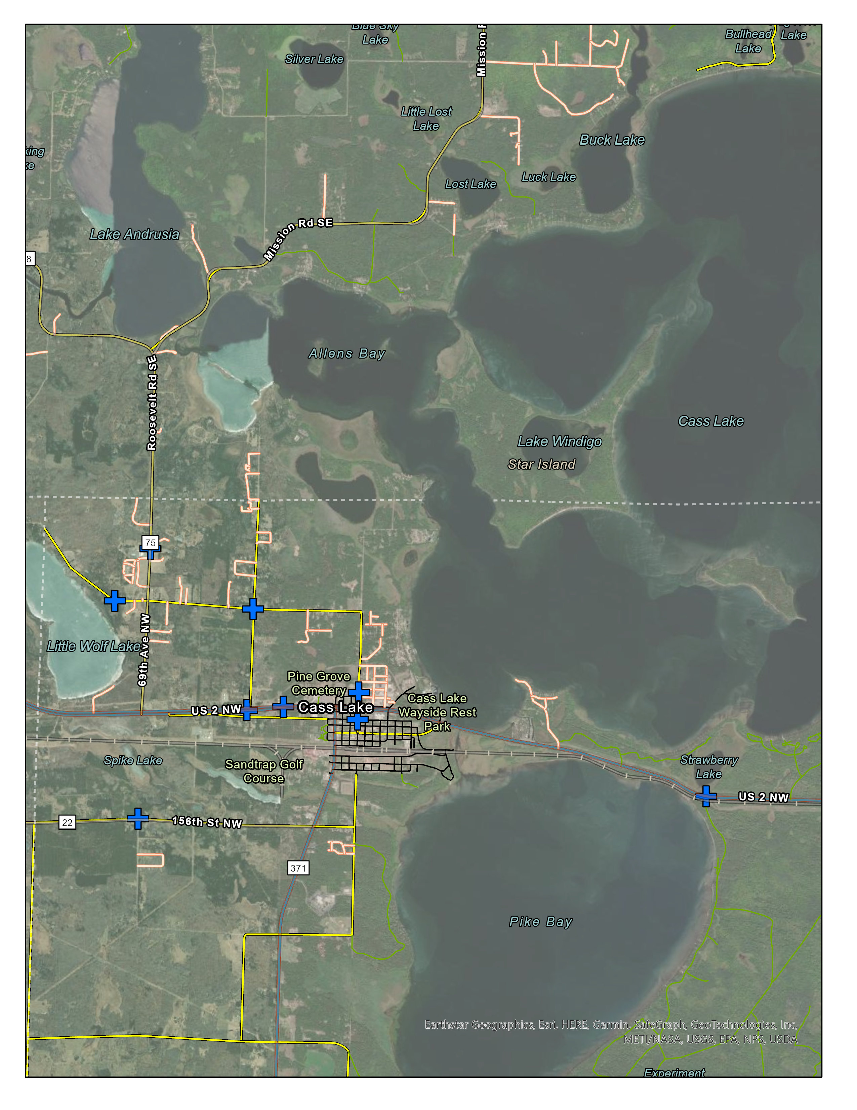
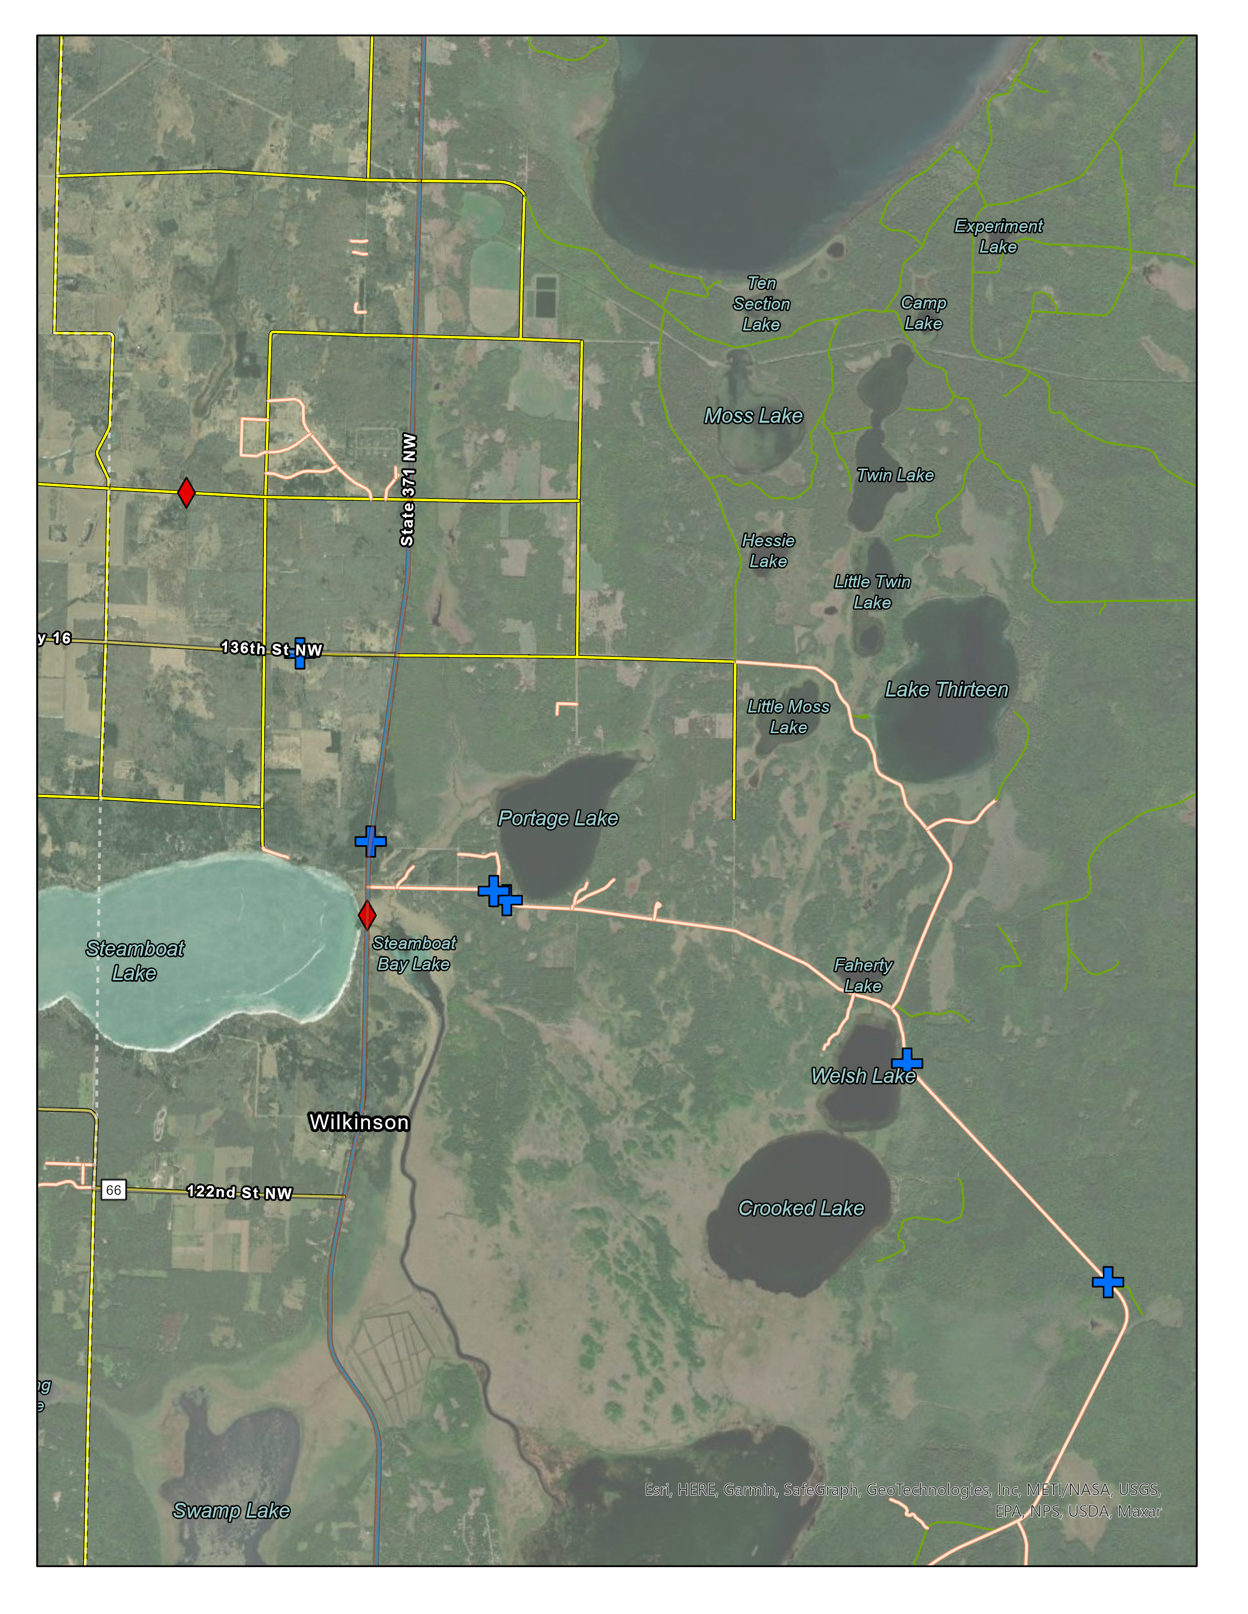
Cass Lake Area
Steamboat Springs Area

Slide 20
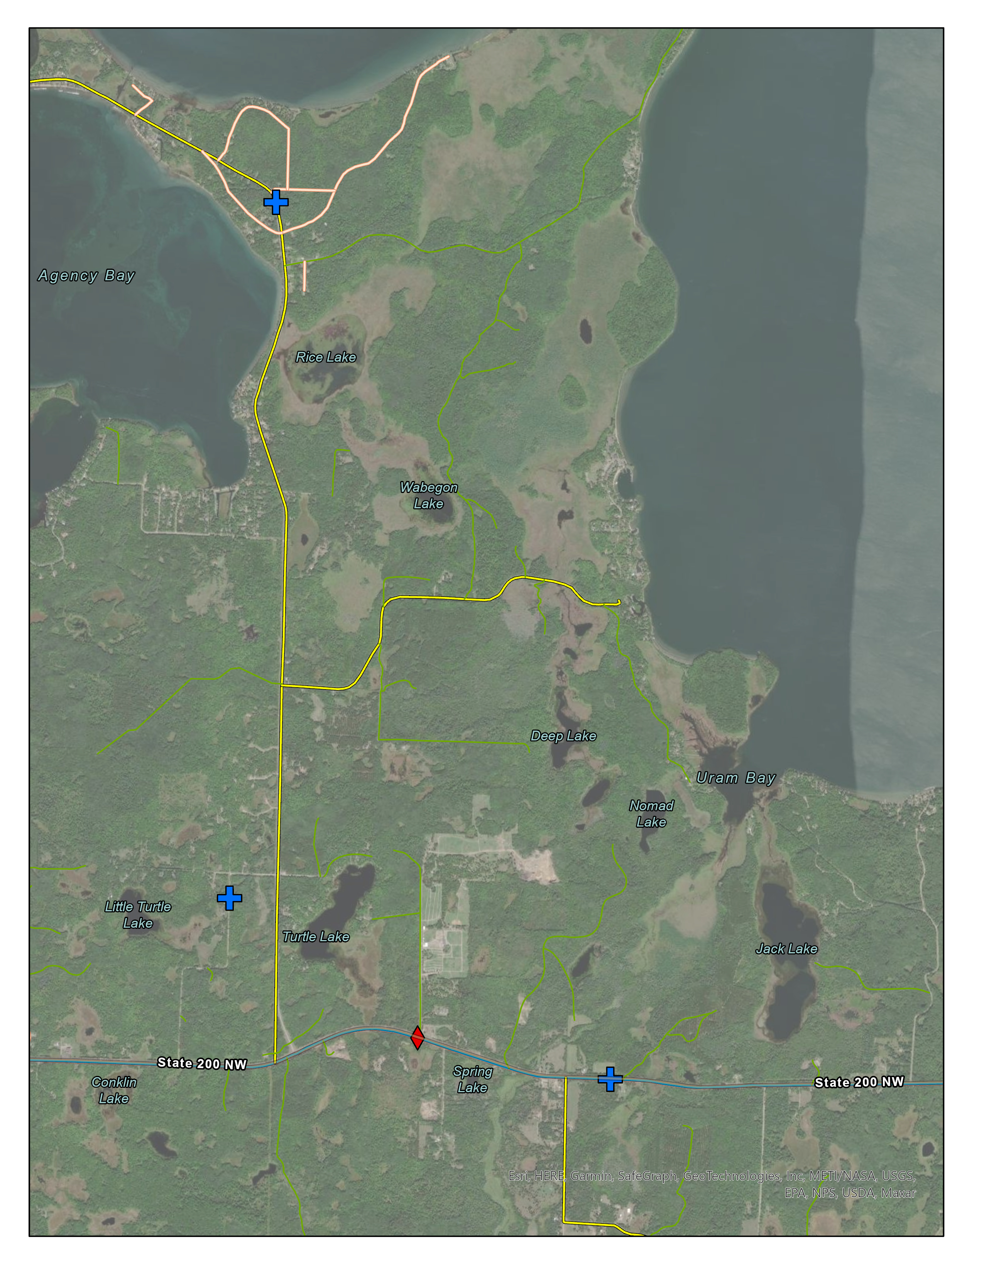
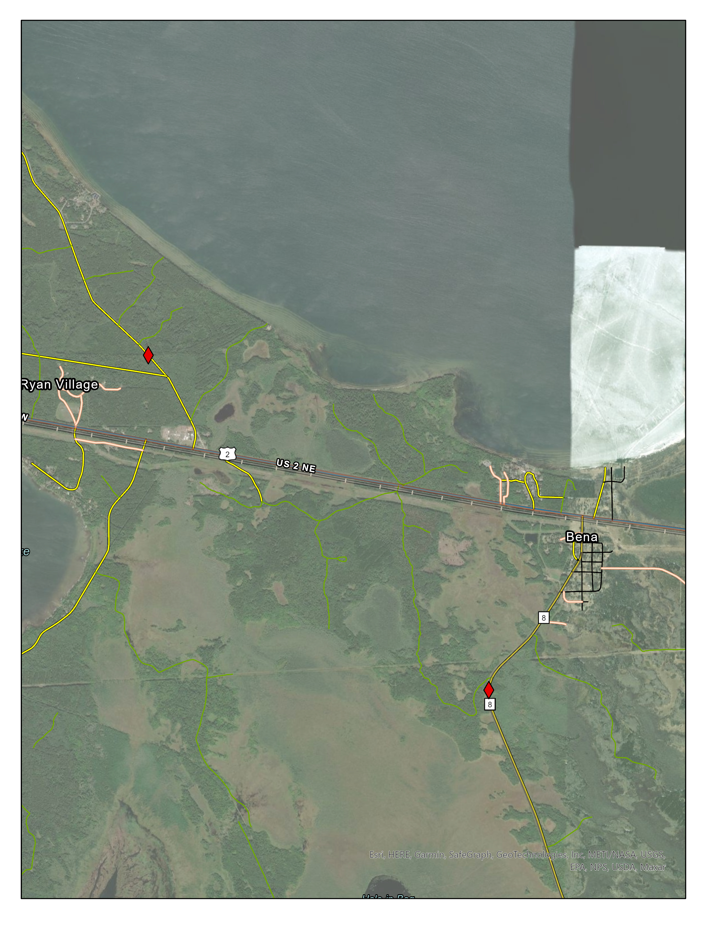
Hwy 200 East of Walker
Bena Area

Slide 21
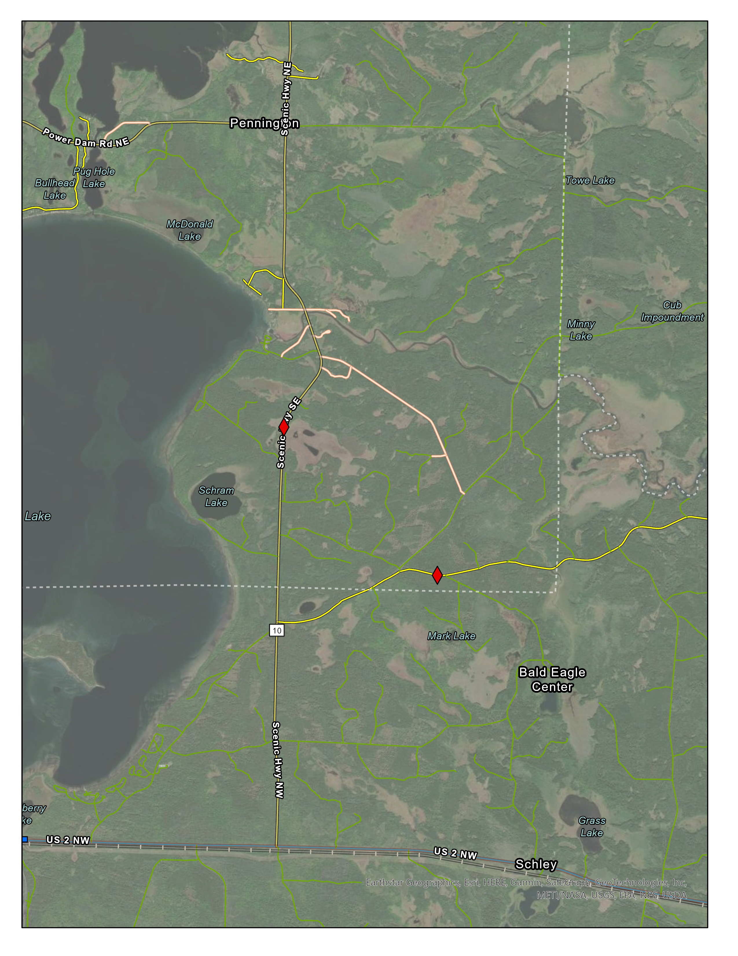
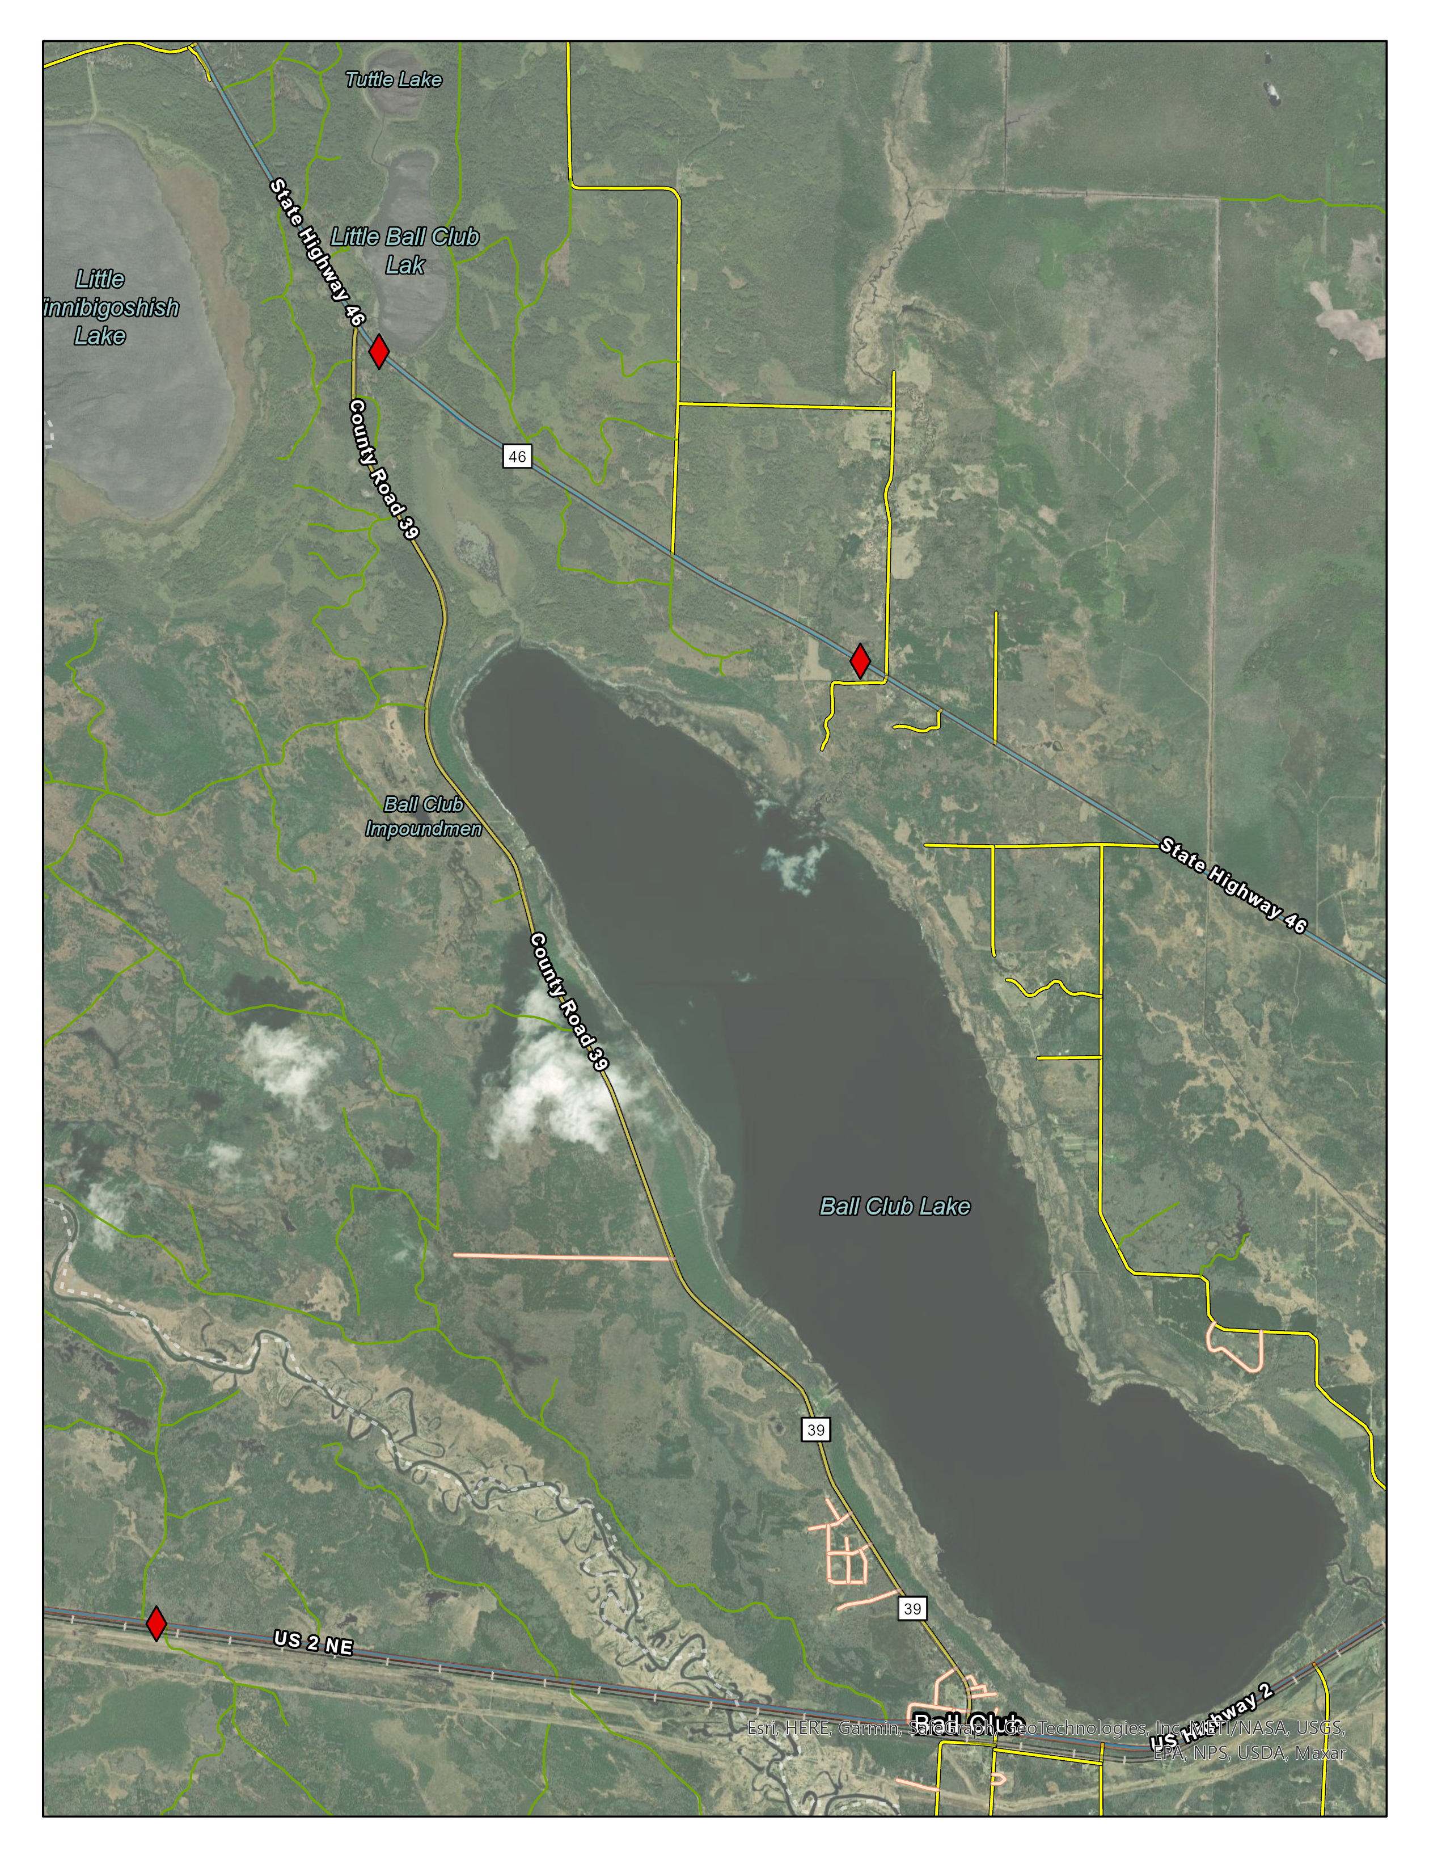
Lady Slipper Byway
Ball Club Area

Slide 22
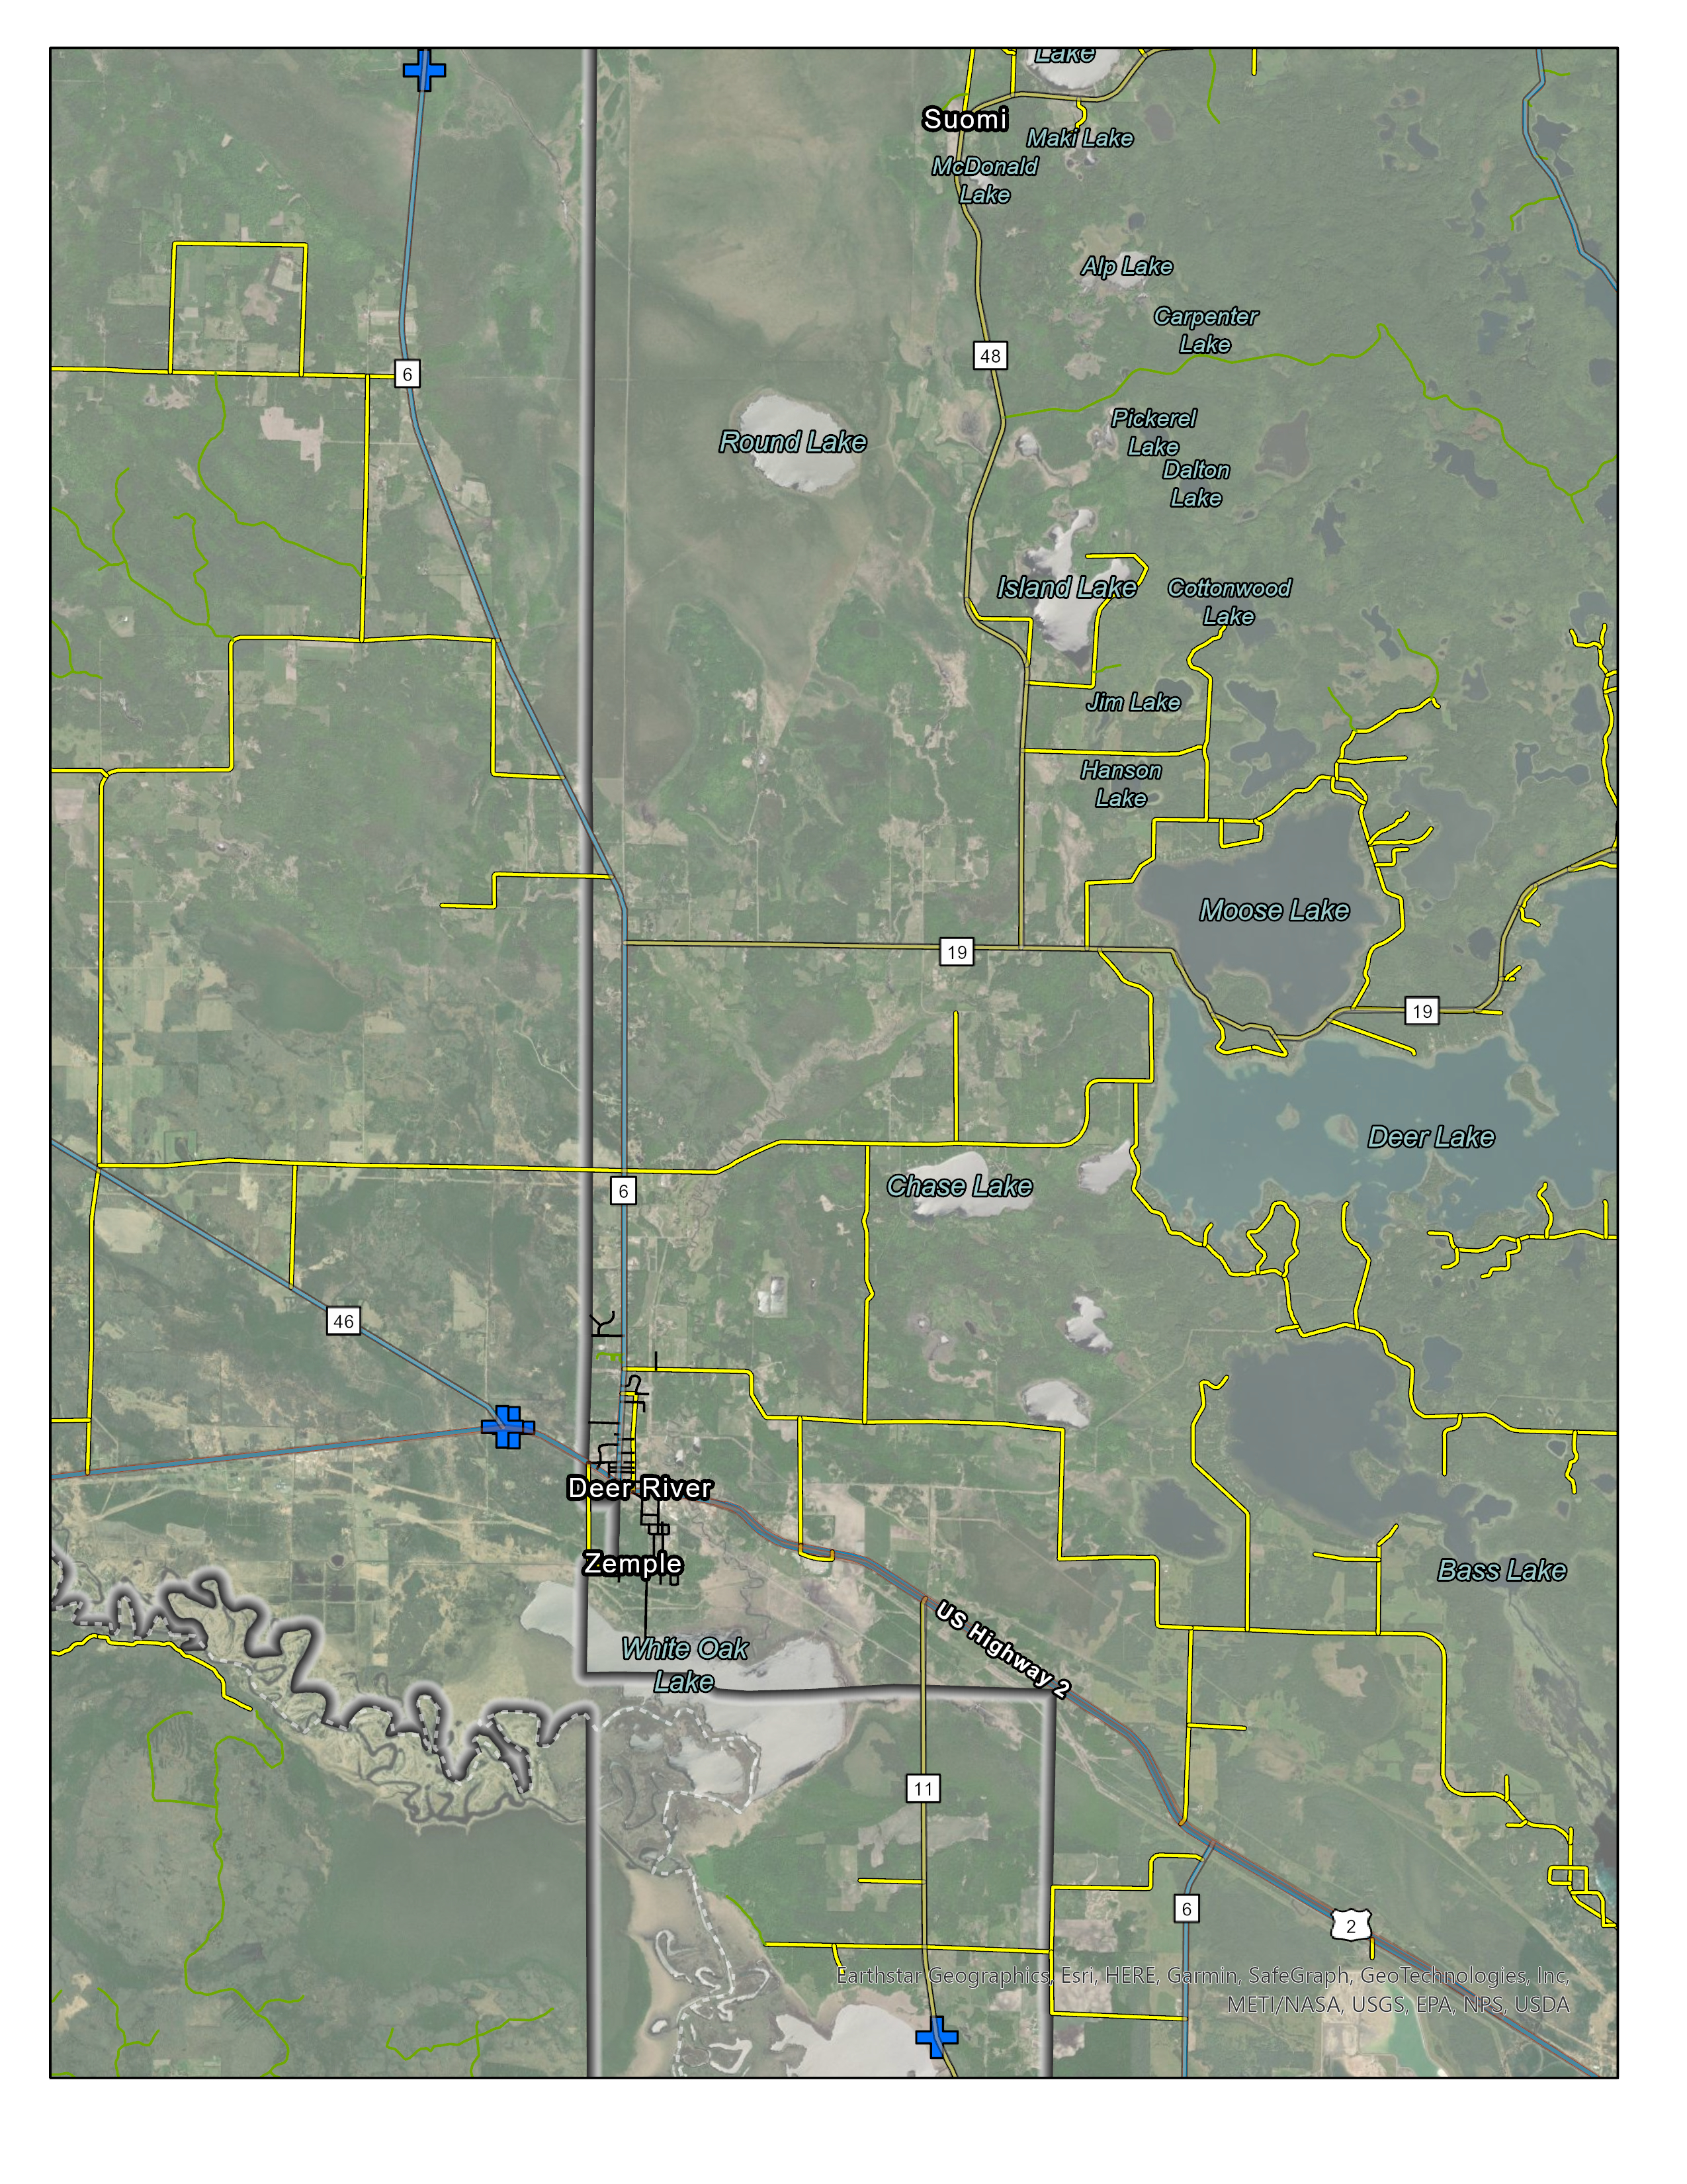
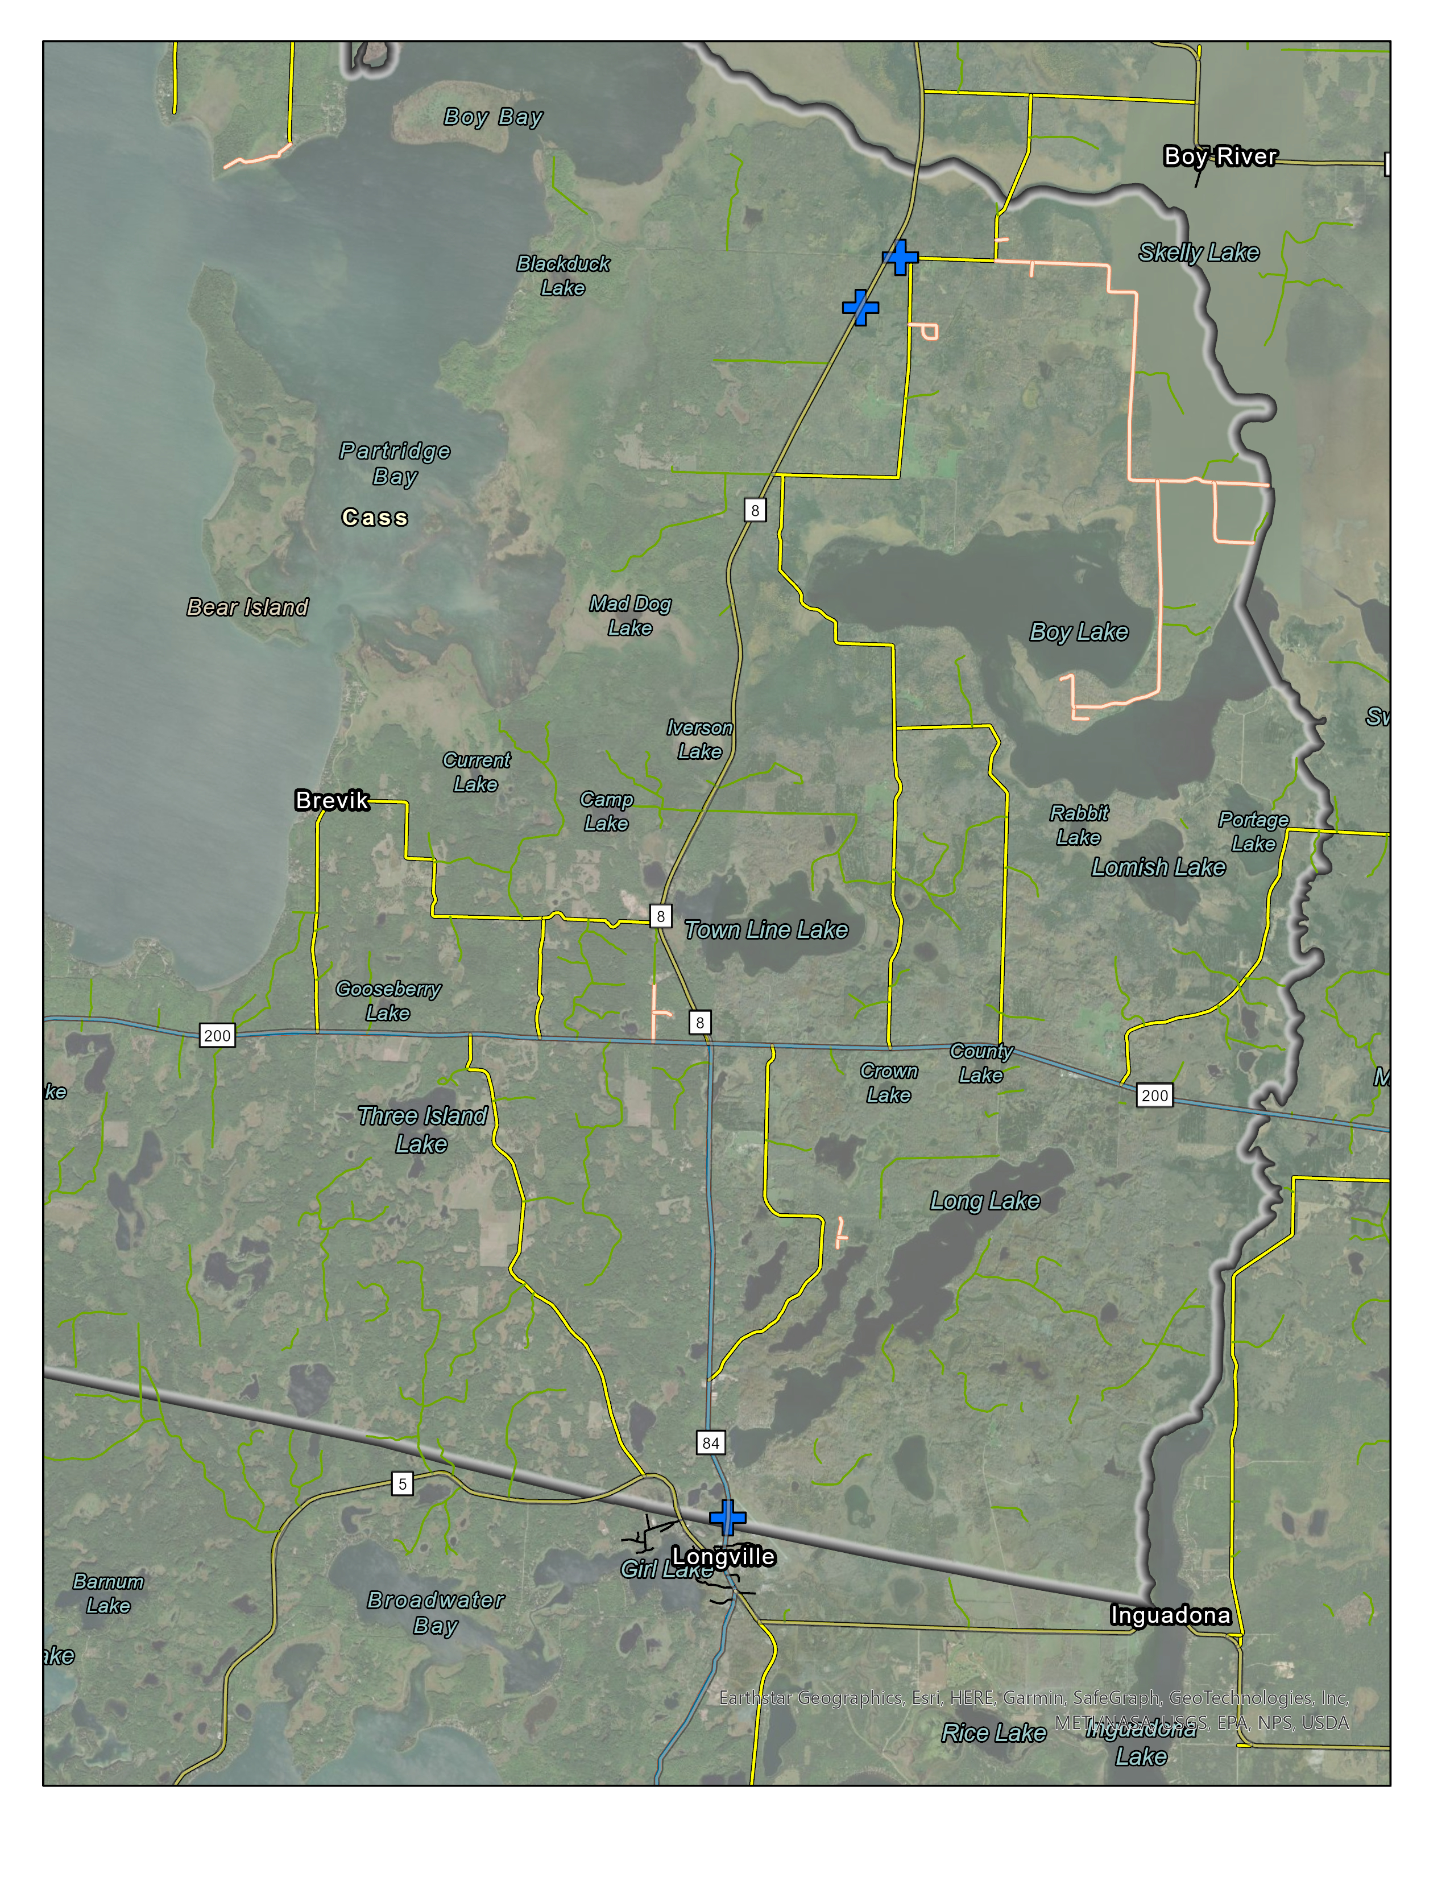
Deer River Area
Federal Dam Area

Slide 23
The Four “E” Approach to Traffic Safety
Engineering
Education
Enforcement
Emergency Care

Slide 24
Workgroup Activity
What do you think are some dangerous roads within the reservation?
What emphasis areas should LLBO focus their safety efforts to reduce serious injury and death?
Who else should be involved with this process?

Slide 25
Next Steps
Public Surveys and Outreach
Additional Data Collection
Meeting #2: Late October

